Slide 1
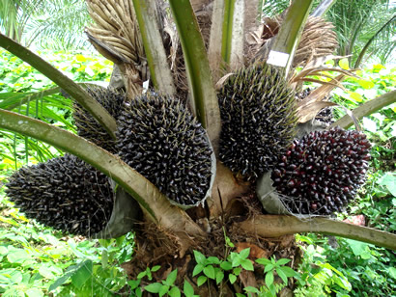
Measure Phase Automated Palm Pruner
Presented by:
Obie Abakporo
Bill Carpenter
William Craig
Juan Antonio Rojas
Christopher Xavier Smith
Sarah Trayner
December 8, 2011

Slide 2
Introduction
The Palm Pruning project is based on providing an efficient, economical, and effective means of harvesting fruit from oil palms
Review of Define Phase
Customer requirements
Research
Concept generation
Comparison of concept ideas
Positives
Negatives
Concept Selection

Slide 3
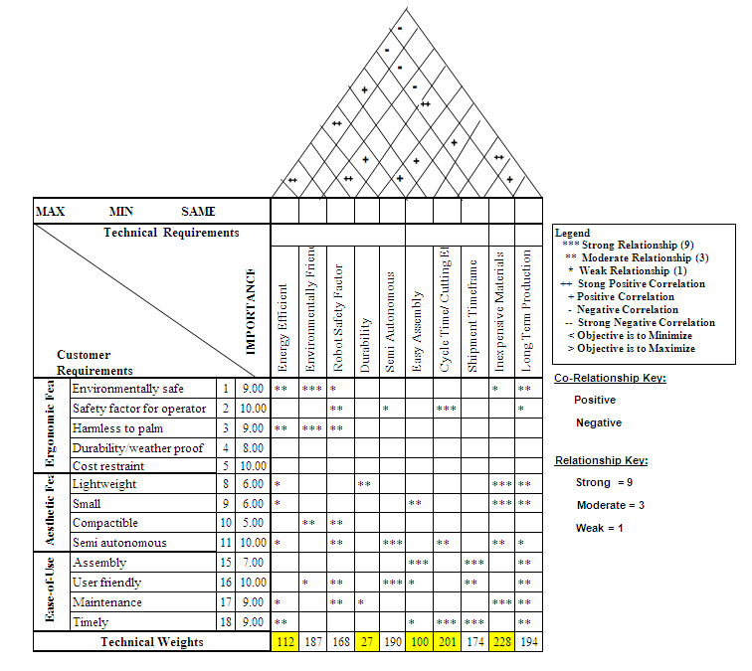
House of Quality

Slide 4
Concept 1 – King Climber
Components
Frame
Actuators
Guiding Rails
Cutting Track

Slide 5
Engineering Analysis - King Climber

Slide 6
Engineering Analysis - King Climber

Slide 7
Engineering Analysis King - Climber

Slide 8
Concept 2 – Rolling Thunder
Components
Circular Frame
Legs
Wheels
Motors
Springs

Slide 9
Engineering Analysis - Rolling Thunder
Raw Material Lengths (Al 6061) | Length (inches)
Circle Track | 89.54
Struts (x3) | 24
Legs (x3) | 48
Total needed: | 161.5
Material | Weight (lbs)
Frame | 7
Wheels | 18
Motors | 2
Pay Load | 25
Springs | 5
Total | 57

Slide 10
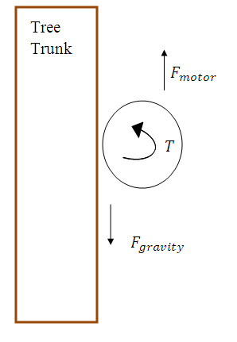
Engineering Analysis - Rolling Thunder

Slide 11
Metrics
Major measurements for each design
Cost
Power
Weight
Force
Speed
King Climber
$857.30
71.12 Watts
125.9 lbs
50.36 lbs
.075 ft per sec
Rolling Thunder
$509.65
80 Watts
107 lbs
24 ft-lbs
1 ft per sec

Slide 12
Design Selection
Methods
Quantitative
Qualitative
Ranking
Tools
Venn Diagram
Traditional Selection Matrix
Pugh Diagram

Slide 13
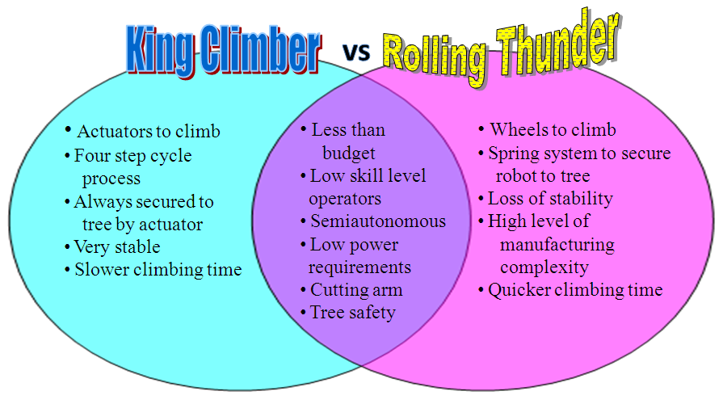
Venn Diagram

Slide 14
Traditional Selection Matrix
This matrix provides a basic understanding of each design and identifies which is the most suitable in layman’s terms.

Slide 15
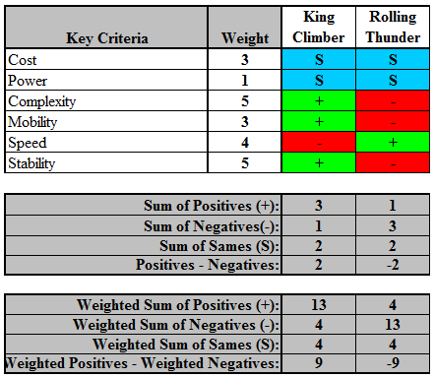
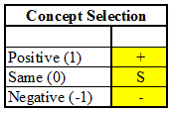
Pugh Selection Method
Pugh Matrix
Matrix Key

Slide 16
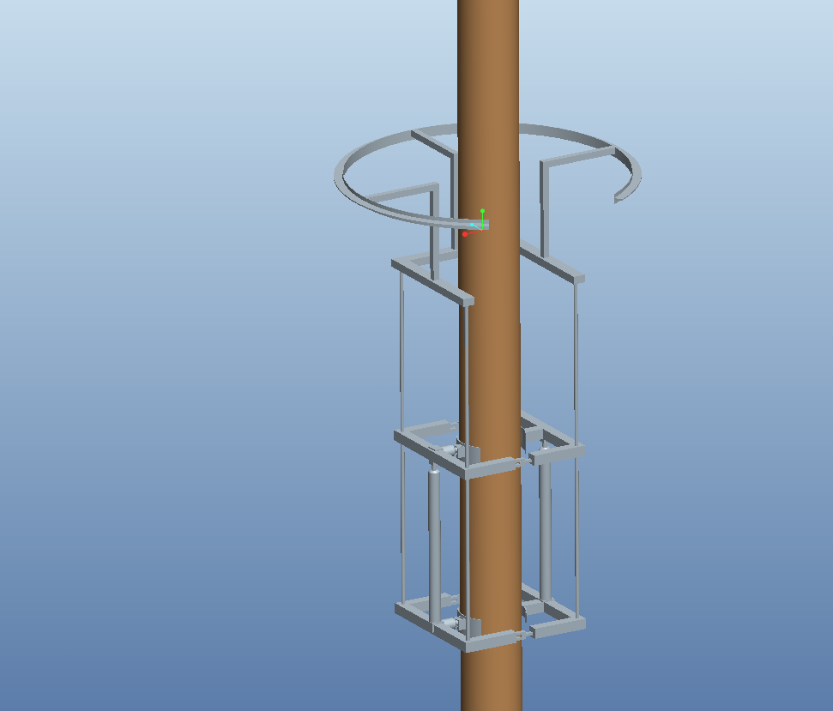
Final Selection
KING CLIMBER WINS!
More stable
Best user safety
More effective
Less complex

Slide 17
Conclusion
King Climber is the better choice
Used engineering analysis
Selection tools
Ordered parts
Begin fabrication and assembly

Slide 18
Questions
Enjoy your break!!

